Slide 1
Instacart - Market Basket Analysis
Marketing Analytics

Slide 2

Instacart Overview
Problem Statement
Data Description
Data Exploration
Part A: Predictive Modeling
Part B: Recommendation Algorithm
Recommendations
Agenda

Slide 3





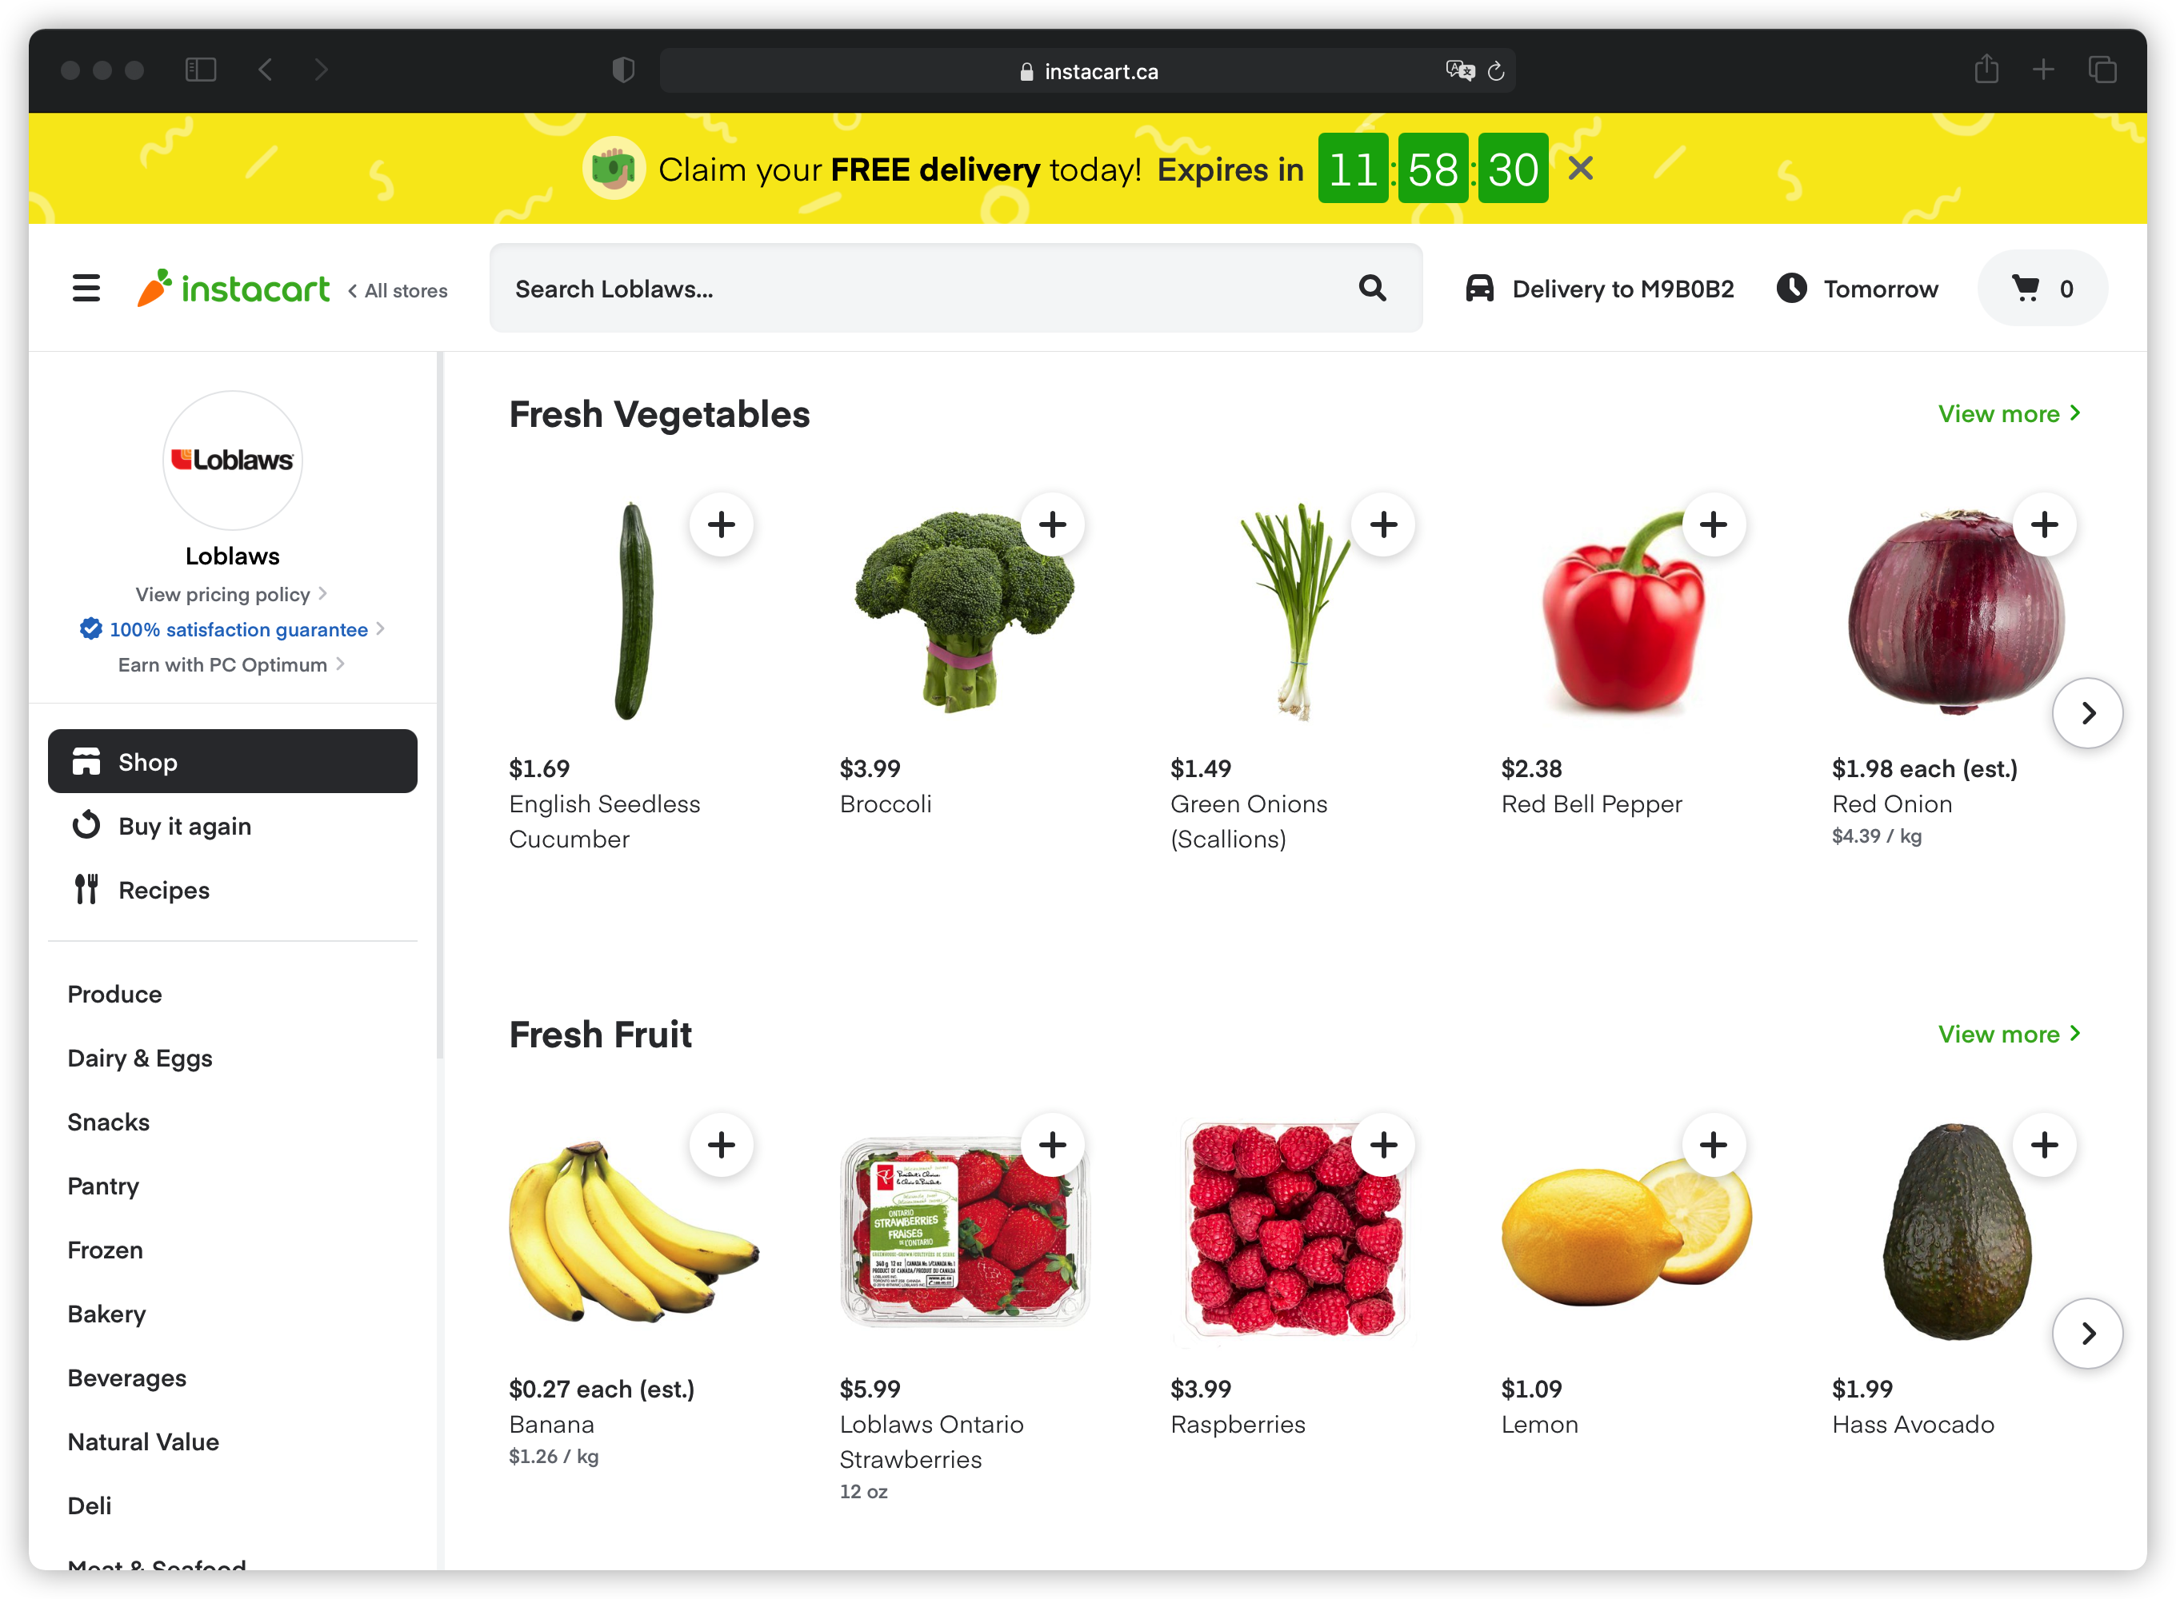
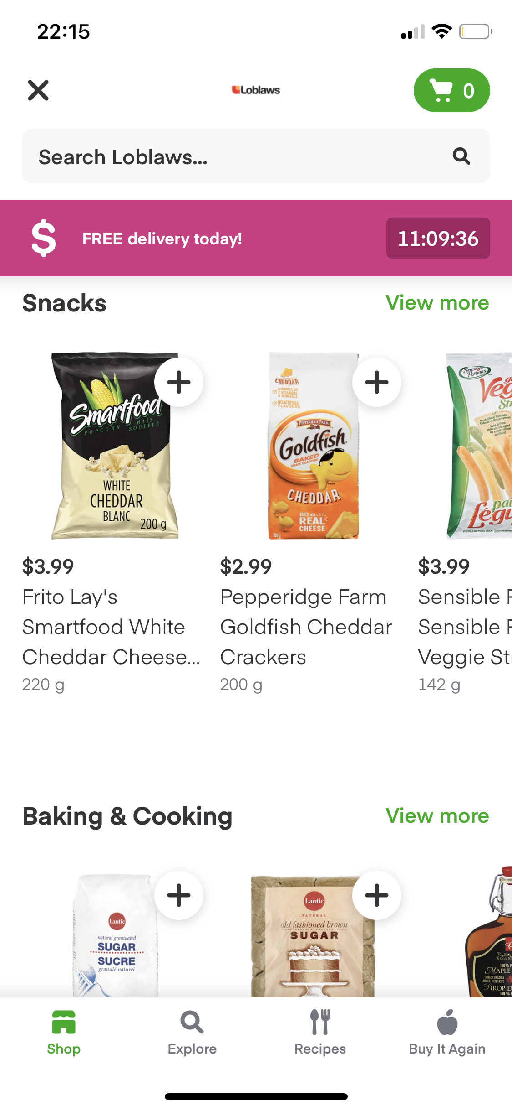


Instacart Introduction
Select location
Buyer
Delivery to your doorstep
Vendor
Receive order
Create Shop and List Grocery products
Transfer Amount (payment and commission)
Select Available Store
Receive payments
Manage Website
Select Grocery Products and Pay
Admin

Slide 4

Problem Statement
“Instacart is challenging the Kaggle community to use this anonymized data on customer orders over time to predict which previously purchased products will be in a user’s next order.” - Kaggle
Objectives
Anticipate user’s next purchase
Increase basket size by using recommendation engine

Slide 5
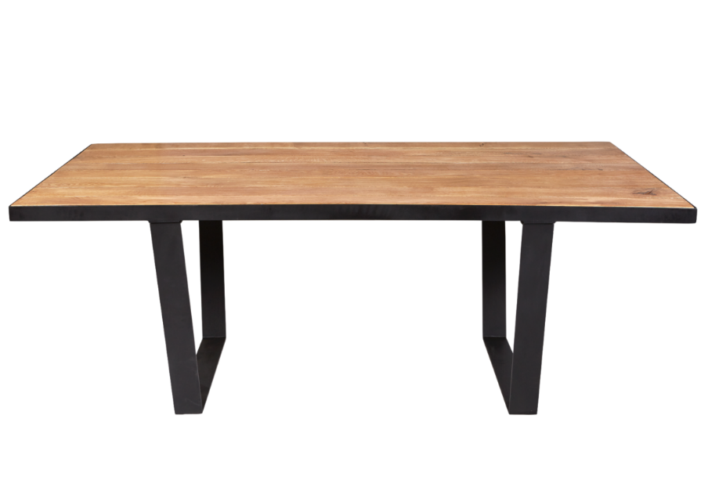
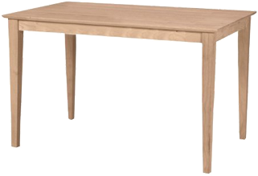
Data Descripti0n
Orders
Order_id
User_id
Order_number
Order_dow
…
Order_products
Order_id
Product_id
Add_to_cart_order
Reordered
…
Products
Product_id
Product_name
Aisle_id
Department_id
…
Aisles
Aisles_id
Aisle
Departments
Department_id
Department
Data Source: Kaggle (https://www.kaggle.com/c/instacart-market-basket-analysis)

Slide 6
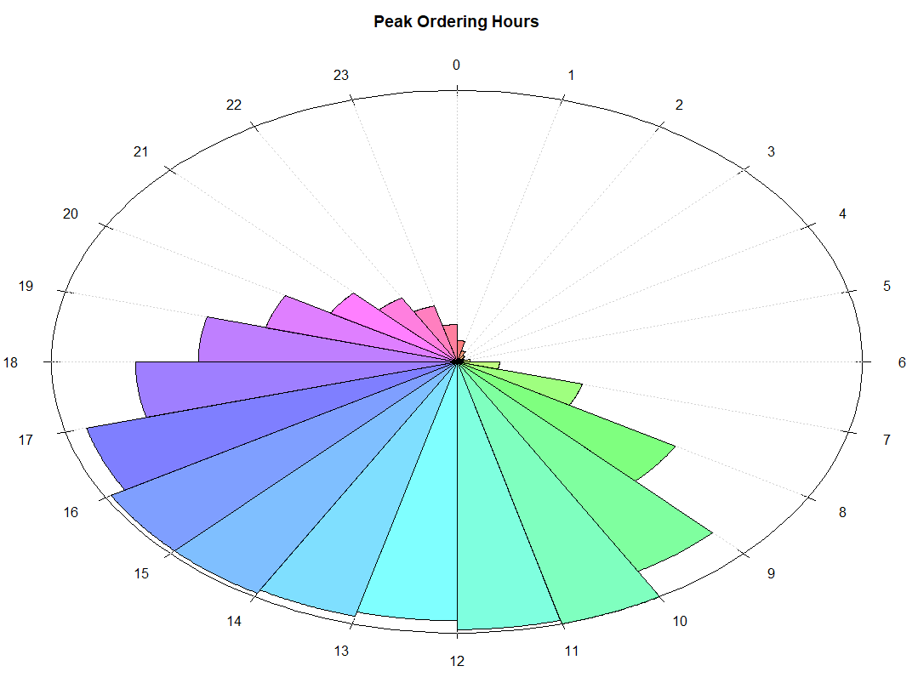
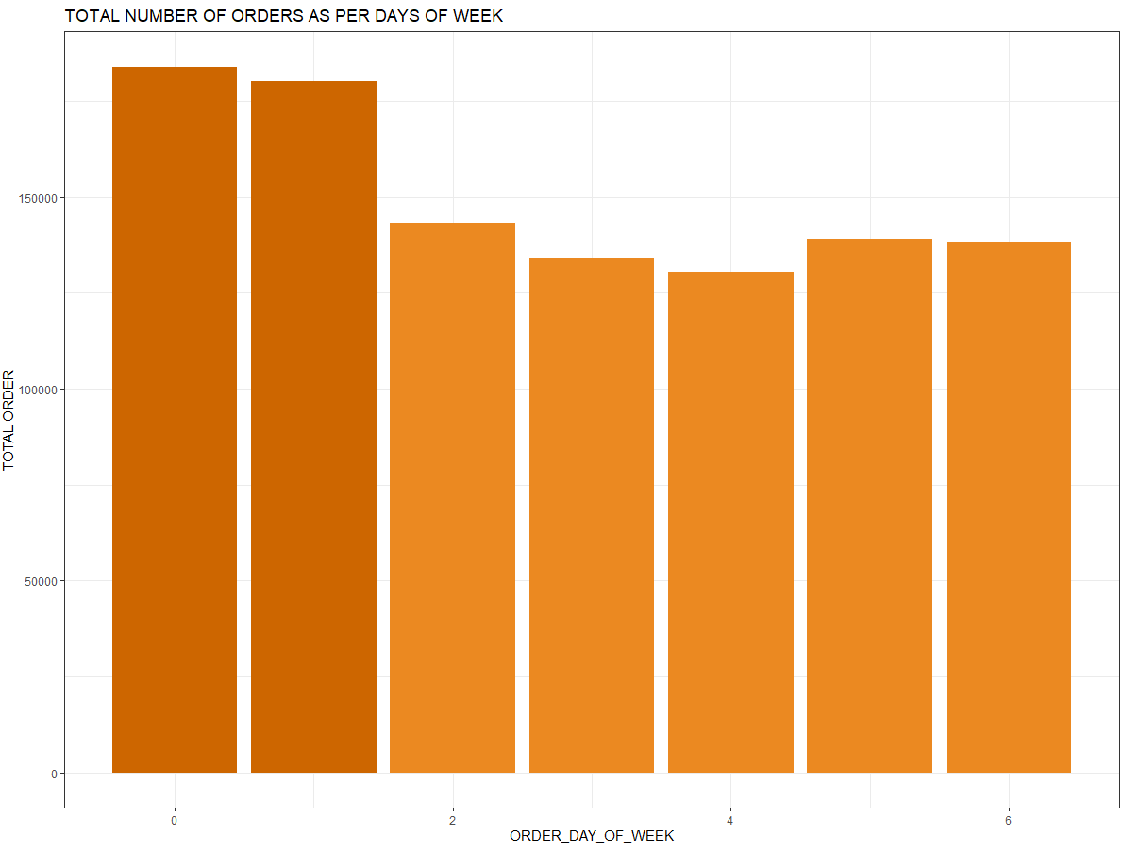
Customer Traffic
Hour of day
Most orders are between 10:00-16:00
Day of Week
Most orders are on day 0 and 1 (Sat & Sun)

Slide 7
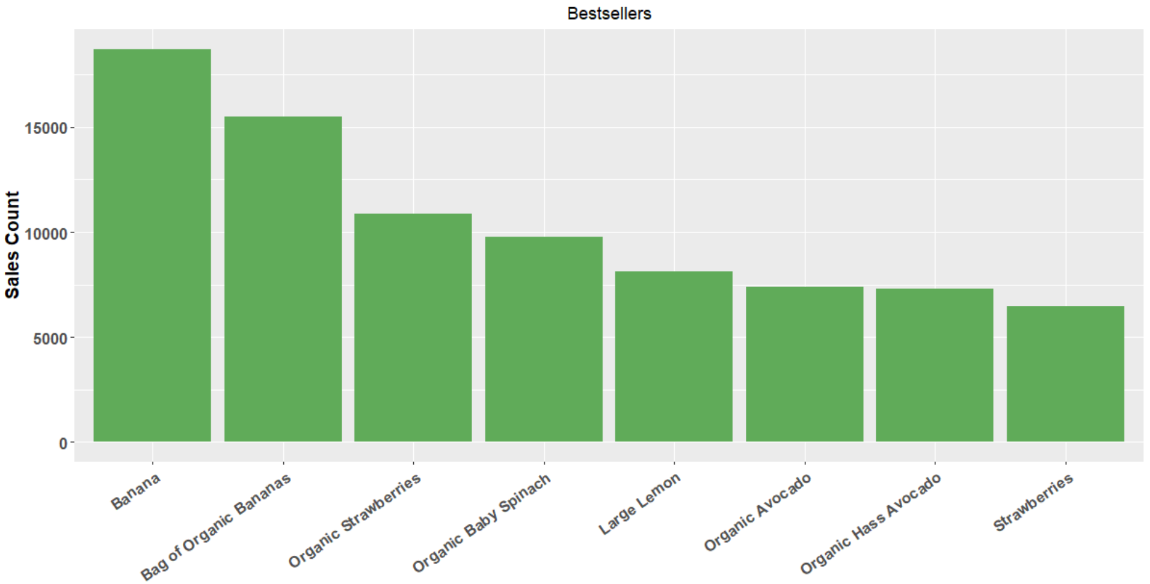
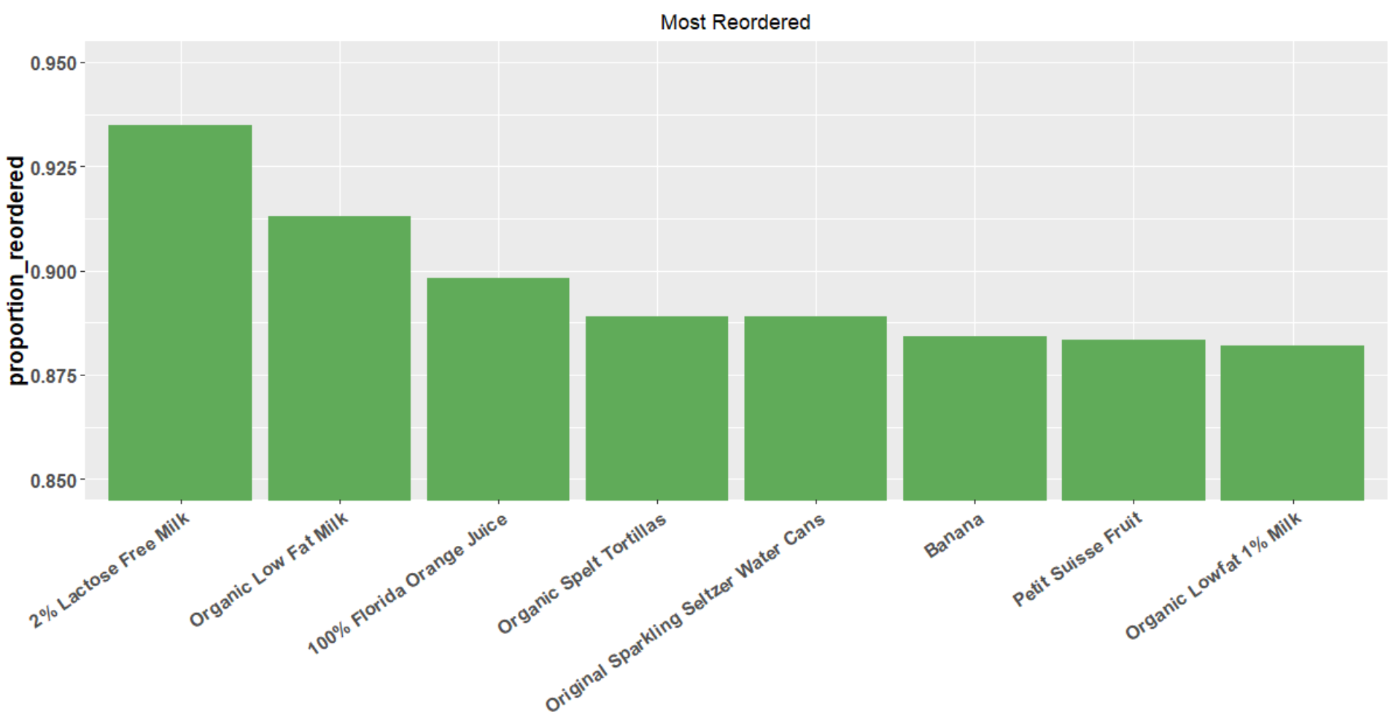
Bestsellers/Most reordered
Best Seller - Bananas
Milk is most likely to be reordered product

Slide 8
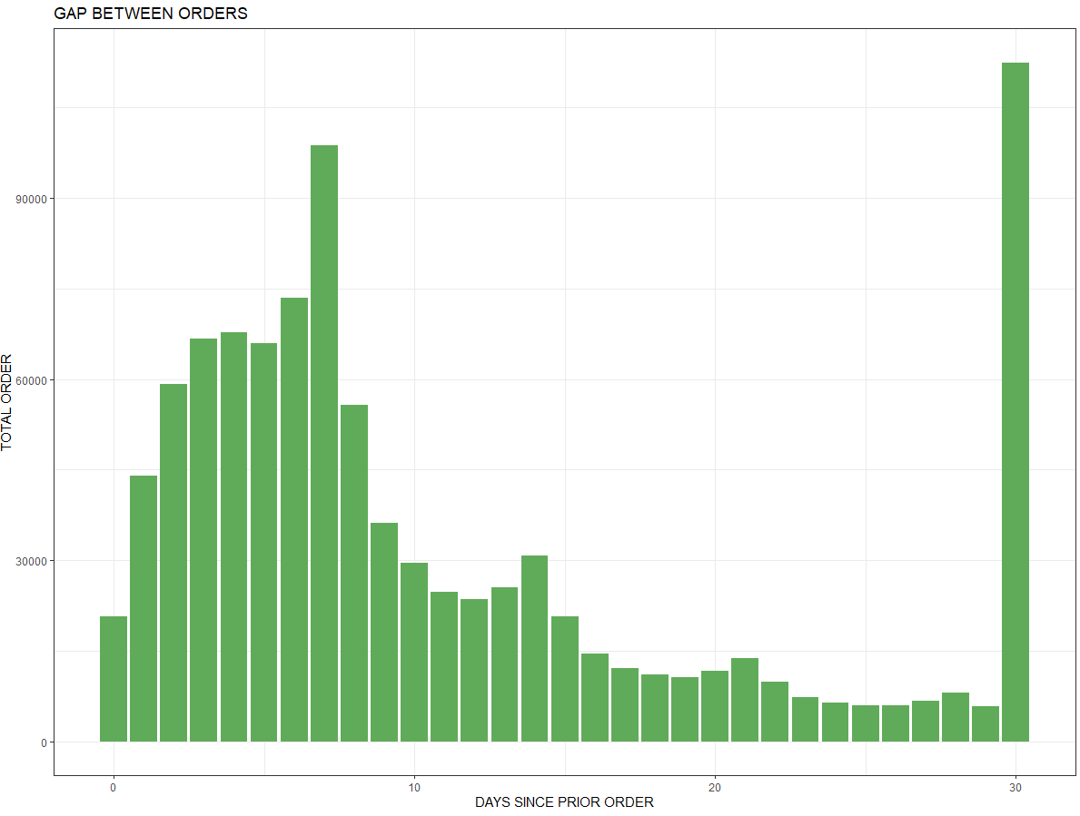
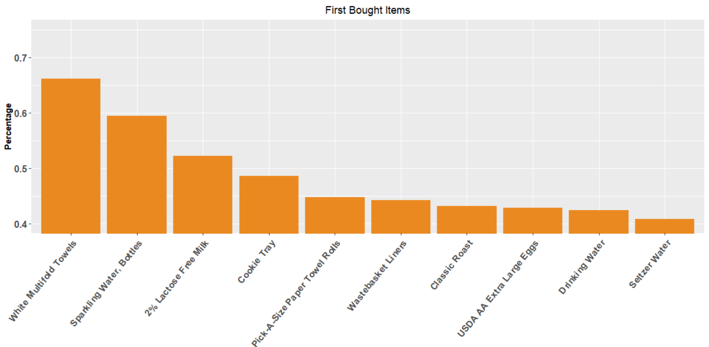
Order Frequency
People seem to reorder on day 7 and day 30
Items bought by first time users

Slide 9

Feature Engineering
User-Based Features (order size, order date, reorder percent, etc.)
Product-Based Features (Reorder frequency, Top list, etc.)
User-Product (Reorder %, Avg. Position in cart, etc.)
Data map: Utilized user-product level data with 130 million obs and 23 variables
Randomly reduce users to 10%
split into 3 sets & 23 features
Target Variable: products from prior orders are present in the latest order - 3 Models

Slide 10
Predictive Model Results Summary
Model | Accuracy | Precision | Recall | F1 Score
Decision Tree | 0.9062 | 0.1621 | 0.6050 | 0.2557
Random Forest | 0.9060 | 0.1568 | 0.6041 | 0.2490
Logistic Regression | 0.9063 | 0.1680 | 0.6029 | 0.2628
Accuracy: Our model is approx. 90.63% accurate to predict if the product will be in user’s next order.
Precision: Only 16.8% of all predictive “buy” products are really bought in next order.
Recall (Sensitivity): We have labeled 60.29% correct “buy” products of all products truly be added in cart.
F1 score: F1 Score is the weighted average of Precision and Recall.

Slide 11
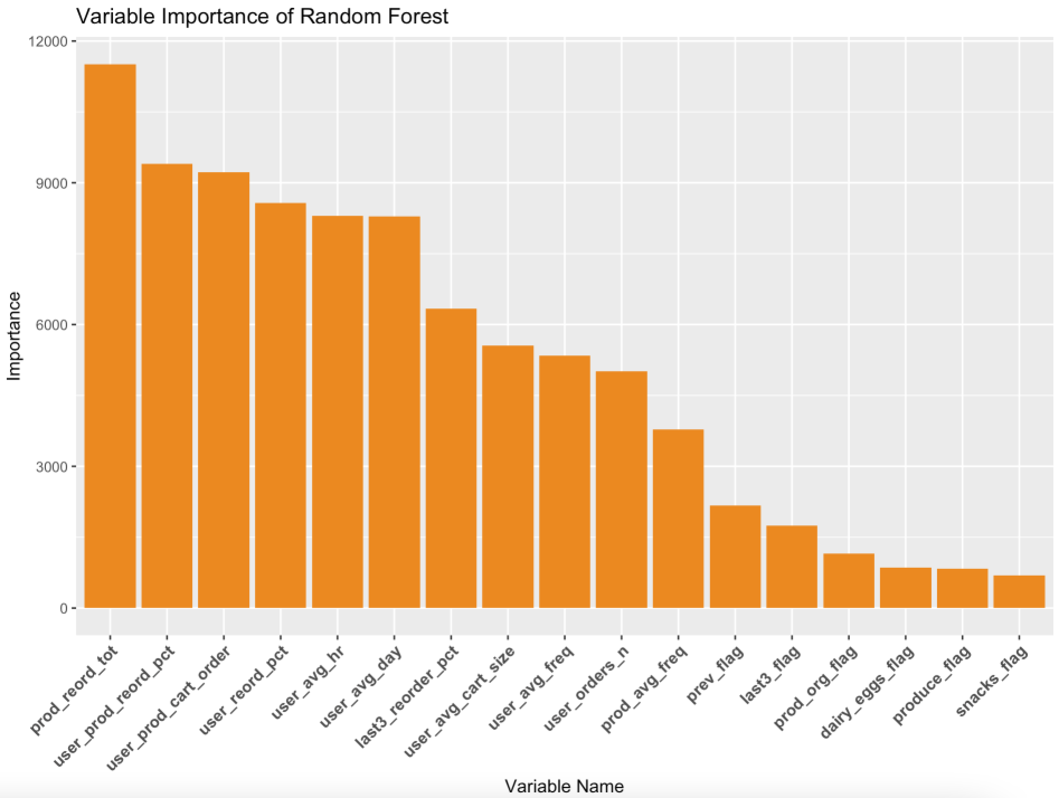

Result Analysis
Positive Feature for reordering
Numbers of total products reordered
Product in the customer’s most recent carts
Percentage for all the reordered orders and products
The product's average position in the cart by the user
Variable Importance
Extension analysis:
Apriori algorithm – what are the products bought together?

Slide 12
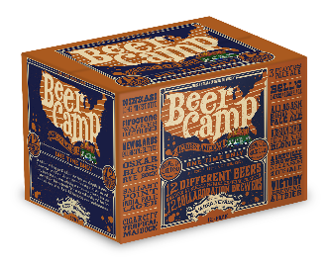
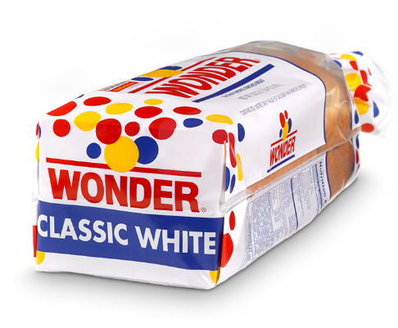
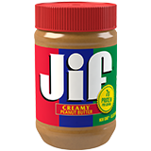


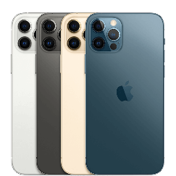




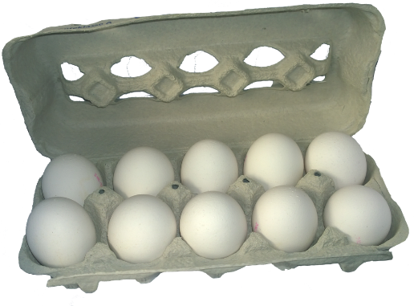



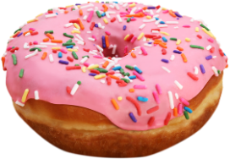
Apriori : The “You may also like” algo
Rule

Slide 13
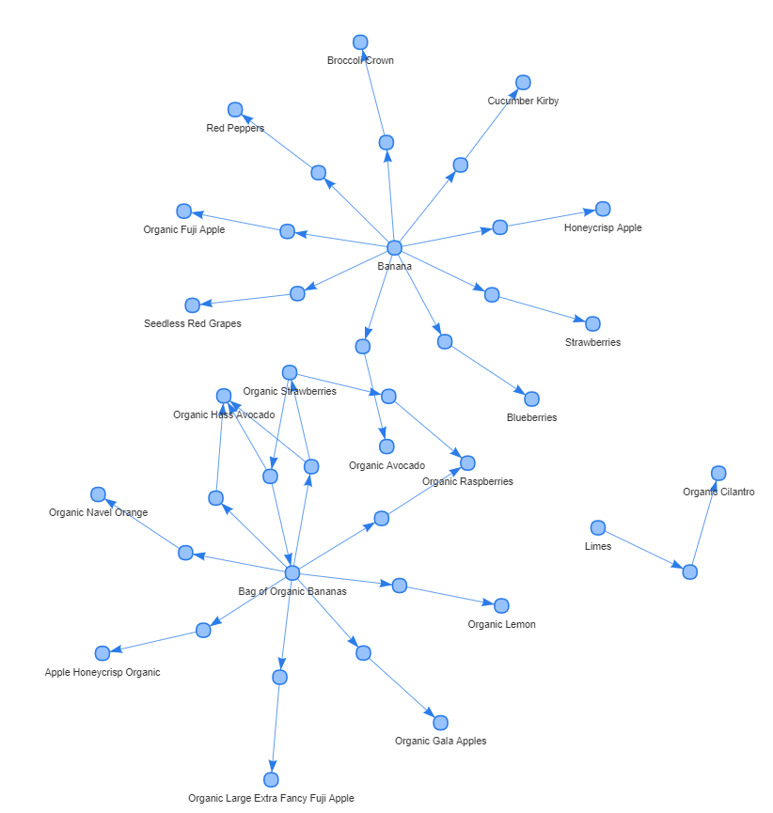
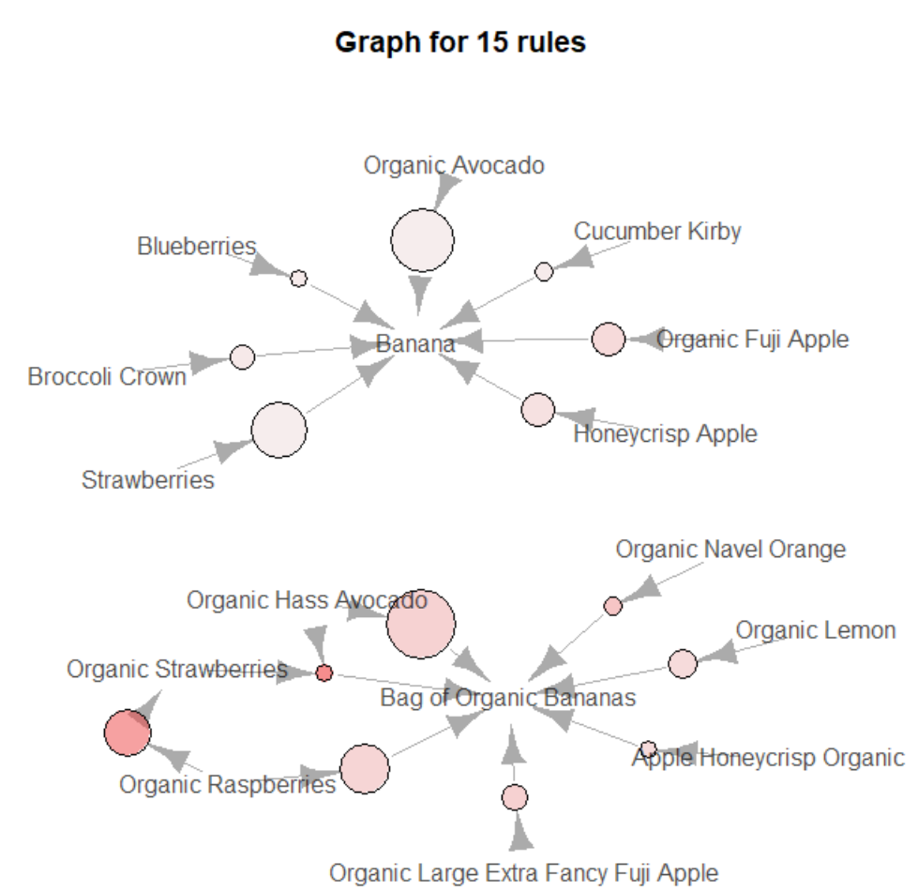
Findings

Slide 14



End-to-End Flow
Recommended Products
Organic strawberries
Blueberries
Broccoli Crown
Organic Fuji Apple
Login with User_id
Prediction Model + Apriori Algorithm

Slide 15

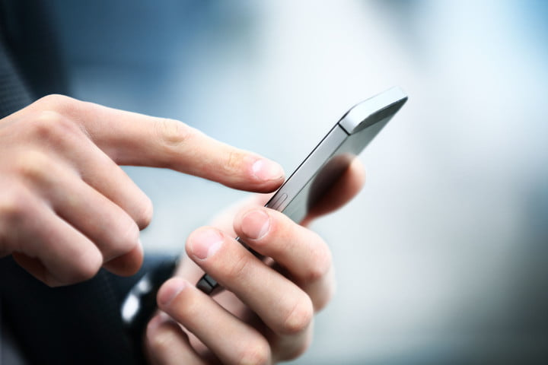
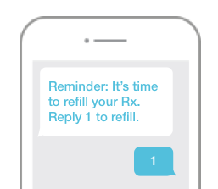
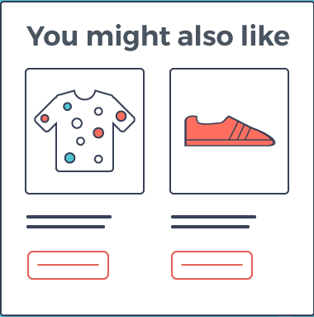
Recommendations
Improve model accuracy for predicting users' frequency
Purchasing Patterns
Targeted marketing campaigns based on users' activity & frequency of visit
Connect recommendation engine with users buying behavior
Recommendation Engine
User should be suggested with the products that they are most likely to buy next.

Slide 16
Thank you

Slide 17
Appendix

Slide 18
Instacart Business Model Overview
Key
Activity
Value
Propositions
Customer
Relationship
Customer
Segments
1.Creating technological infrastructure
2.Local market management
3.Shopper management
4.Customer services
Customers
1.Convenient way to shop for groceries
2.Delivery for a day even in inclement weather
3.Untouch shopping experience during Covid-19
Users
1.People who want groceries but don’t like shopping or have no time
2.Elderly people
1.Customer services
2. Social Media
Key
Partner
Shoppers
1.People who want to earn extra income
2.People who like shopping
3. People who have a smartphone and a car or bicycle
1.Local grocery store
2.Grocery Shoppers
Channels
Key
Resources
Shopper
1.Flexiable working schedule
2.Additional income
1.Web app
2.Mobile app for Android
3.Mobile app for IOS
1.Partnership with local stores
2.Shoppers
3.Technology
Stores
1.Increase in sales
2.Increase in number of customers
Stores
1.Those aim to boost sales
2.Those want to attract more customers
Cost Structure
Revenue Structure
1.Technological set-up running costs
2.Salaries to permanent employees
3.Commision based payments to shoppers
1.Surcharge on the store price
2.Delivery fees
3.Instacart Express Membership fee

Slide 19
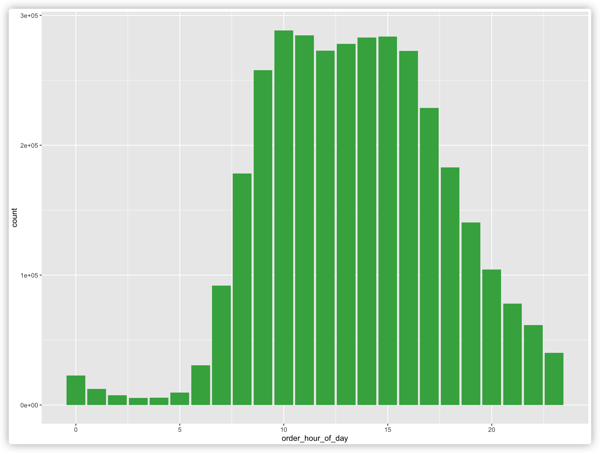
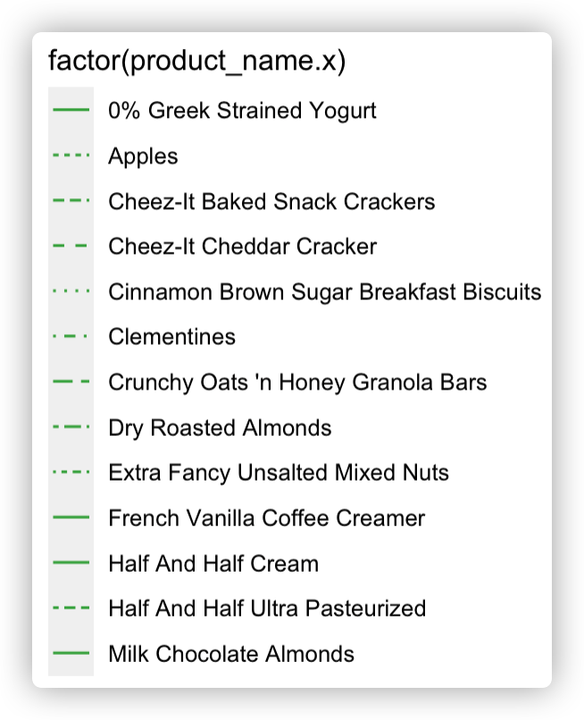
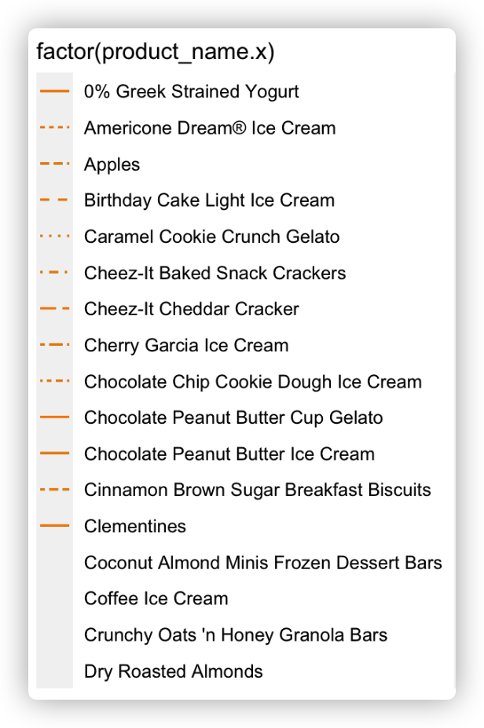
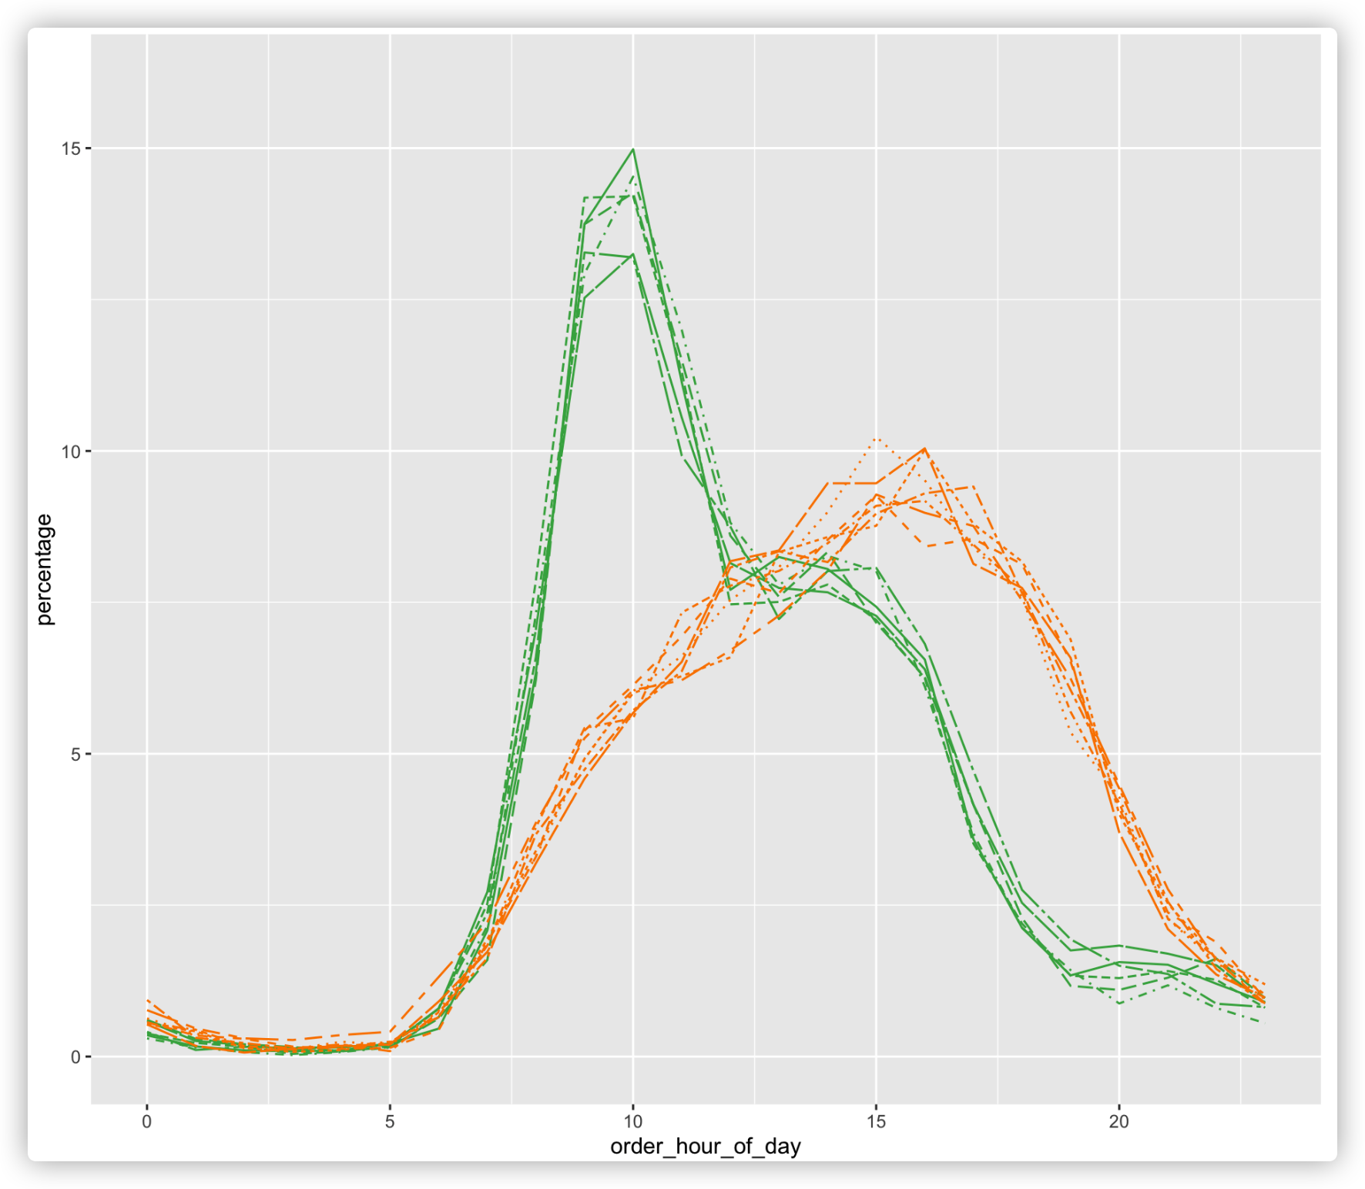
Data Exploration: Hour of the day
Whether there are concentrated time slot ppl love to buy?
10:00-15:00
What do they like to buy in the morning and afternoon?
Pick the top 2000 popular items to study
Conclusion: People love to buy ICE CREAM in the afternoon
Split the morning and afternoon product
Calculate the mean order hour of each product

Slide 20
Data Exploration Highlights
What we study | What we found | What we can do
Hour of the day | 10:00AM-18:00PM are the peaking hours | Schedule shoppers and re-stock to keep the grocery filled with demand products
Day of the week | Sunday and Monday high sales, Thursday is the lowest | Arrange more shoppers on Sunday and Monday and less in the mid weekdays
Days since prior order | Customers always buy weekly (7 days) and monthly(30 days) | Update recommendation system to each user when he/she re-log into the app
Product | Banana is the most popular product. Organic products are also popular. | Put the Top popular products (like organic products) and most reordered products on the eye-catching place of the interface
Aisle | Fruit &Vegetables, Milk and eggs are on the top | Frequently schedule store staff to check the freshness and best-before date of these products
Department | Products, Diary eggs and Beverages are on the Top | Collaborate closely to the product distributors to keep the supply of these high-demand products
Reordered product | Almost 59.9% products are reordered again. Milk is most reordered product | Milk should be in the first place for reordering suggestion.
Added first to cart | White multifold towels are added to the cart at first mostly | Some daily necessities should also be listed in the reorder suggestion based on a regular time mode.

Slide 21
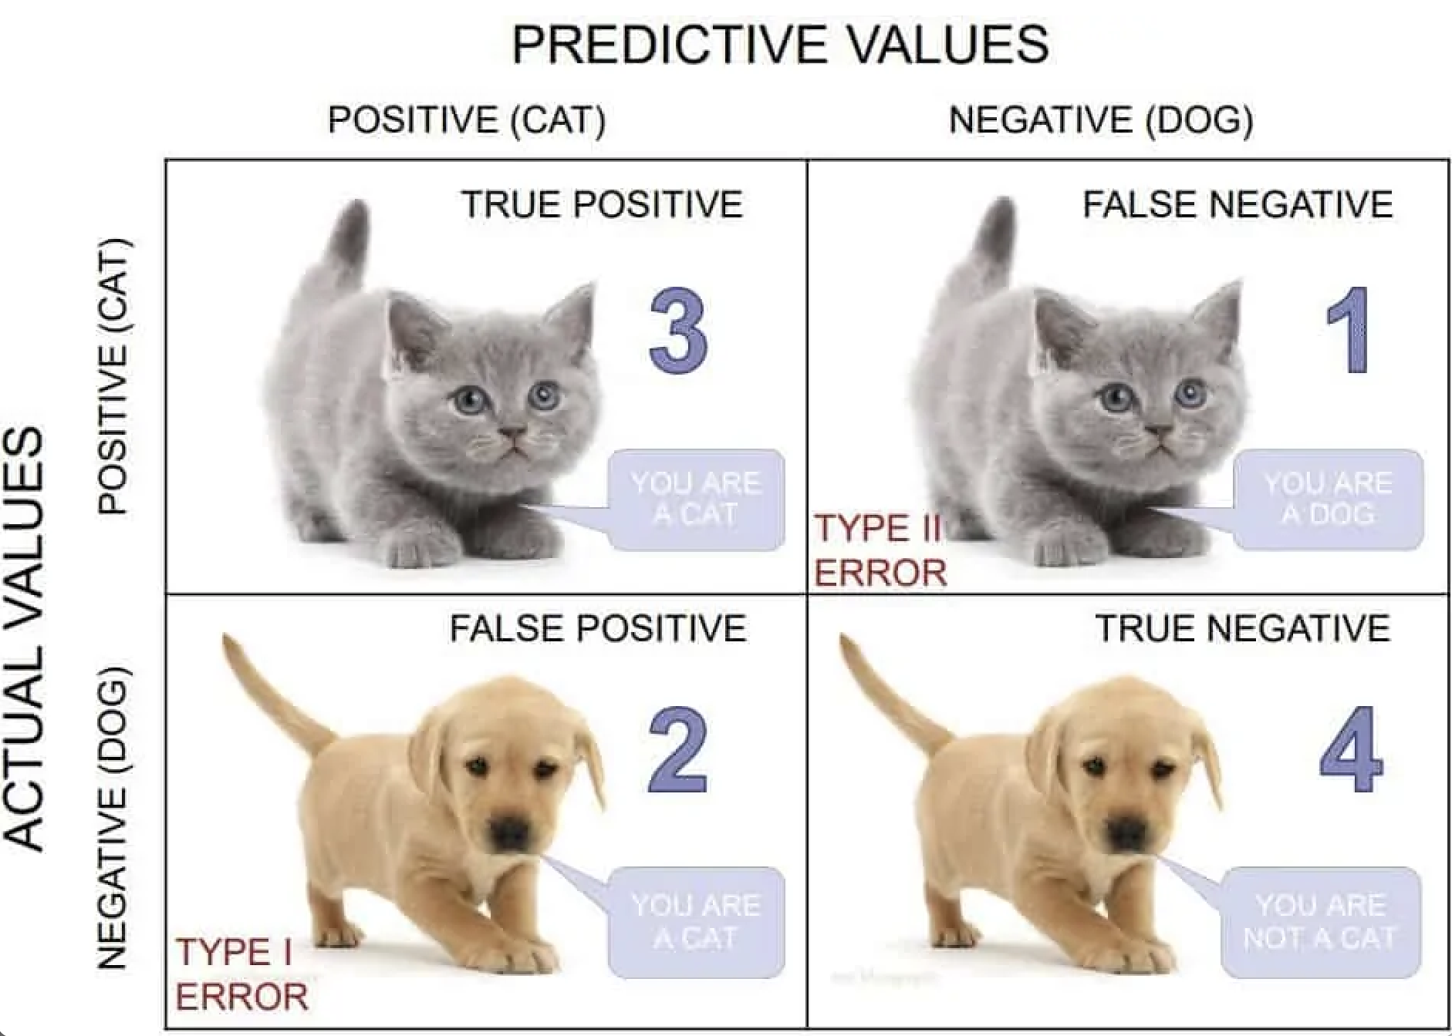
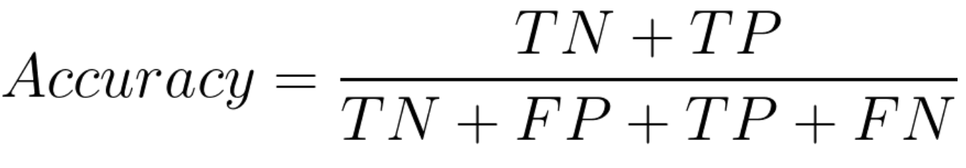
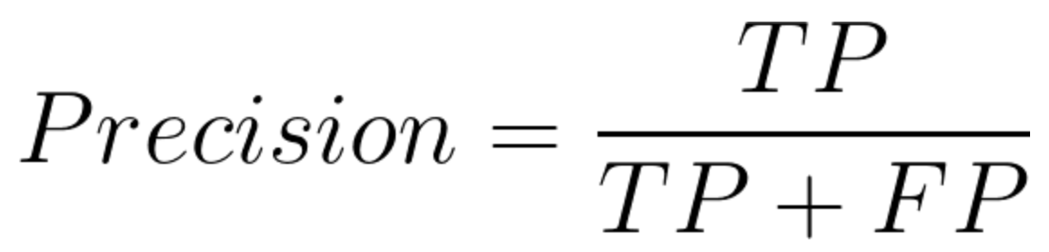
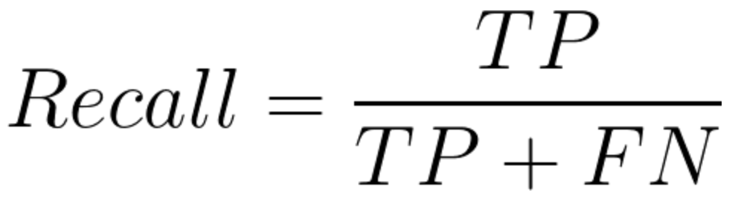
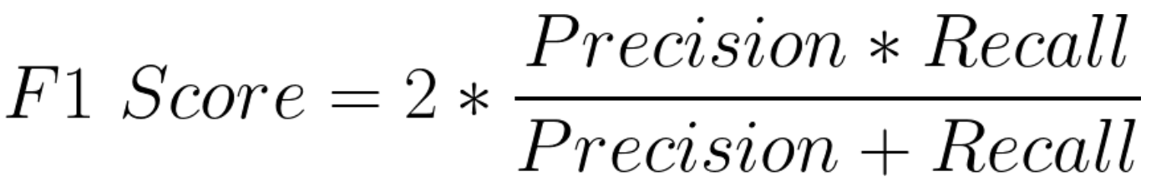
Model Measure Explanation
True Positives (TP) - These are the correctly predicted positive values which means that the value of actual class is “yes” and the value of predicted class is also “yes”.
True Negatives (TN) - These are the correctly predicted negative values which means that the value of actual class is “no” and value of predicted class is also “no”.
False Positives (FP) – When actual class is “no” and predicted class is “yes”.
False Negatives (FN) – When actual class is “yes” but predicted class in “no”.

